Slide 1

DAYANANDA SAGAR UNIVERSITY AI Based Plagiarism Detection System
By:
Girish babu M B (ENG24AM0176)
Raviteja L (ENG24AM0075)
P V S Puneeth Reddy (ENG24AM0248)
M R L Arjun Reddy (ENG24AM0348)

Slide 2
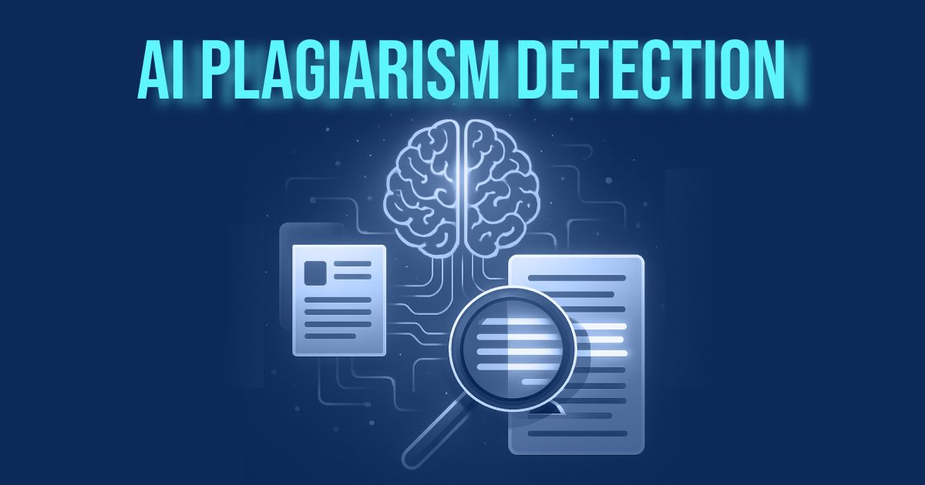
CONTENTS: 1. INTRODUCTION 2. LITERATURE REVIEW 3. METHODOLOGY 4. RESULT 5. CONCLUSION 6. REFERENCE

Slide 3
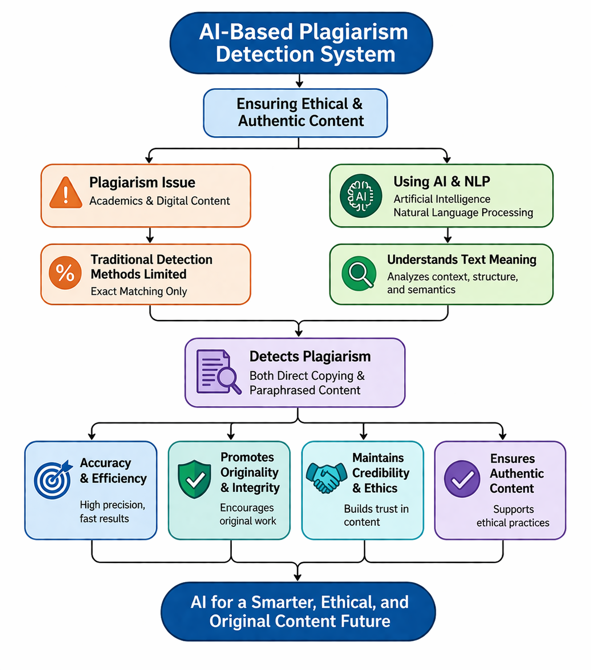
INTRODUCTION:
Plagiarism is a major issue in academics and digital content creation.
Traditional detection methods are often limited to exact text matching.
An AI-Based Plagiarism Detection System uses Artificial Intelligence and Natural Language Processing.
It detects both direct copying and paraphrased content.
The system ensures accuracy, efficiency, and originality.
It promotes ethical practices and maintains content credibility.

Slide 4
LITERATURE REVIEW:
Research in AI-generated content detection has gained traction due to the proliferation of AI language models capable of generating human-like text. Early studies focused on rule-based approaches and statistical analysis to identify anomalies indicative of AI-generated content [1].
With the advent of deep learning techniques, particularly transformer-based models like GPT-2 and GPT-3, researchers have explored the use of neural networks for AI content detection. Studies have demonstrated the effectiveness of language model-based approaches in distinguishing between human and AI-generated text [2].
Paraphrase detection is a critical task in natural language applications in processing, plagiarism with detection, question answering, and text summarization. Early research in paraphrase detection primarily focused on lexical and syntactic similarity measures, such as cosine similarity and edit distance metrics [3].

Slide 5
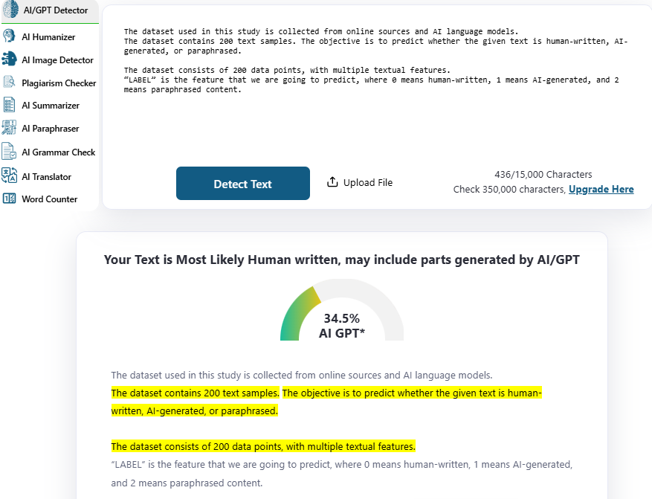
METHODOLOGY:
The proposed methodology uses multiple machine learning classifiers to detect AI-generated and paraphrased content. Text data is preprocessed and transformed with NLP techniques. We extract features using embeddings and similarity measures. Models are trained and evaluated with accuracy metrics. The system compares outputs to identify patterns and improve detection performance.
Dataset Description :
The dataset employed for conducting this analysis is sourced through the internet and AI language models.
The dataset includes 75 words . The target of our prediction model is to identify whether the provided text was generated by humans, AI, or has been paraphrased.
The dataset Includes 75 words with a number of different variables.
“OUTCOME” is the feature that we are going to predict, that percentage of word or parts generated by AI/GPT

Slide 6
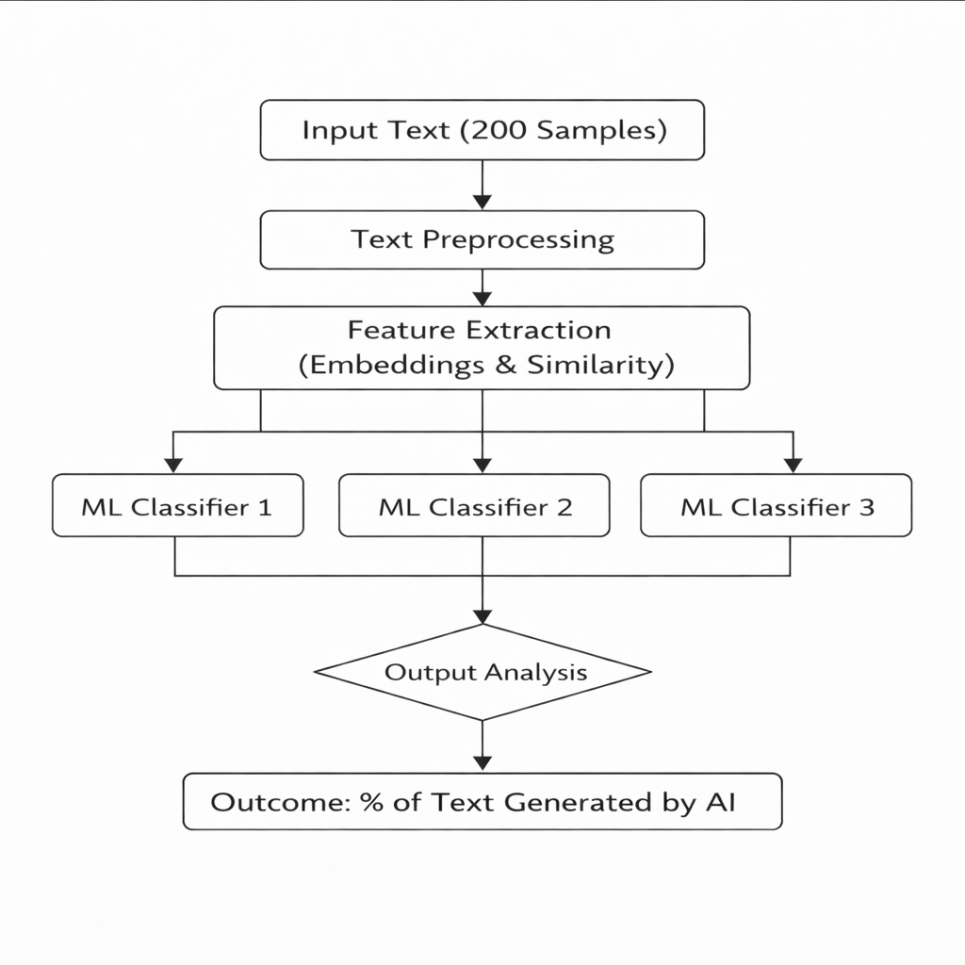

Slide 7
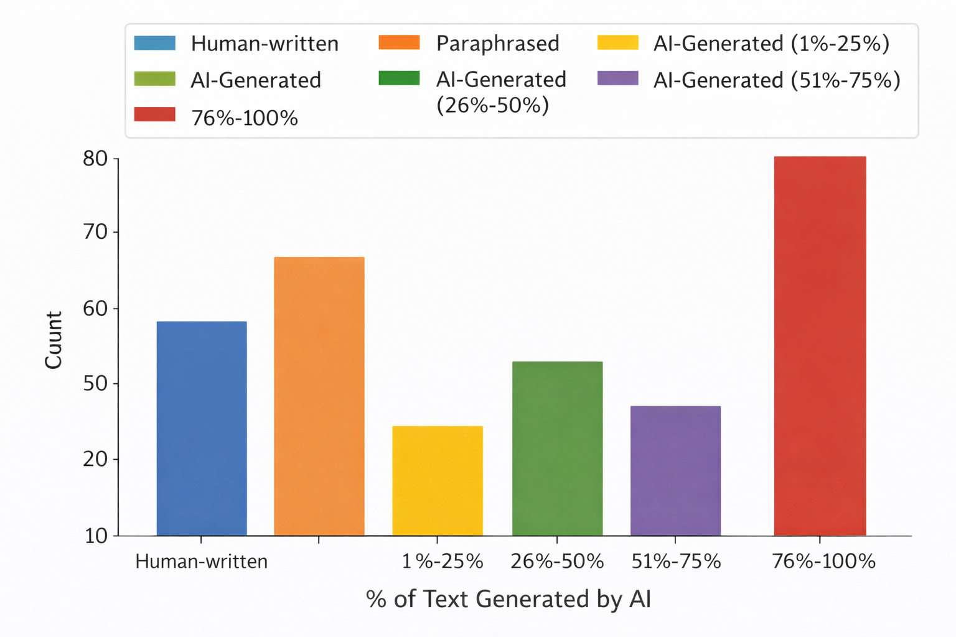
RESULT: Histogram:

Slide 8

As can be seen, no single textual characteristic can completely determine whether it is human-written content or AI-written content. While some characteristics display strong similarities, other characteristics depend on writing styles and formats. From the analysis of plot diagrams, we can understand the distribution of text characteristics and labels within different ranges, thus emphasizing the need for preprocessing. Discretized patterns in the data suggest the existence of categorical differences between human-written text, AI-written text, and paraphrasing content. It should be carefully considered before utilizing machine learning algorithms. The labels contain three types of outcomes: 0 corresponds to human-written content, 1 corresponds to AI-written content, and 2 represents paraphrasing.

Slide 9
CONCLUSION:
Accuracy and Reliability:
The efficiency of the system will depend on its accuracy and reliability. This requires the models used to be trained on a variety of text databases to correctly identify human-generated text, AI-generated text, and paraphrased text.
2. Feature Selection and Importance:
Feature selection is important in choosing the right textual features for use in the model. Some of the textual features include word embeddings, syntactic patterns, and semantic similarity. Feature importance analysis allows one to recognize certain features that aid in detecting AI-generated and plagiarized text.
3. Model Evaluation:
It is important to evaluate the performance of the proposed system based on metrics like accuracy, recall, precision.
4. Data Privacy and Security:
Since the textual data can include confidential information, data privacy and security are essential concerns in order to protect the confidentiality of information.
5. User-Friendly Interface:
The system should have a user-friendly interface which enables easy submission of text by users and clear interpretation of results along with percentages.
6. Continuous Update:
The AI models are evolving with time, and therefore, the system should be continuously upgraded to ensure accurate results.
7. Scalability and Integration:
For greater usage, scalability is crucial along with ease of integration with other academic tools, platforms, and applications.
8. Ethical Aspects:
There are some ethical considerations regarding unbiasedness, fairness, and absence of any kind of biases. The system needs to be evaluated periodically to ensure unbiased results.

Slide 10
REFERENCE:
[1] Baly, F., Mishra, A., & Ekstrand, M. D. (2018). Detecting neural text generation: A benchmark for open domain dialogue systems. In Proceedings of the 27th ACM International Conference on Information and Knowledge Management (pp. 287-296). Link](https://dl.acm.org/doi/10.1145/32692 06.3271743)
[2] Miller, J., Dodge, J., & Slavin, R. (2020). Detecting and assessing AI-generated text: Toward a novel toolkit for summarization and paraphrase detection. In Proceedings of the 2020 Conference on Empirical Methods in Natural Language Processing (EMNLP) (pp. 6650-6660). [Link](https://www.aclweb.org/anthology/20 20.emnlp-main.540/)
[4] Pavlick, E., Omar, A., & Bos, J. (2015). Paraphrase identification through string similarity features. Transactions of the Association for Computational Linguistics,3, 345-358. [Link](https://www.aclweb.org/anthology/Q 15-1025/)

Slide 11


